Slide 1
Classification and Logistic Regression
Instructor: Mohammad Hasan
Office: 13-240
09/18/26
Notes:
Welcome and Introductions

Slide 2
Overview
Categorical Variables and Categorical Features
Multi-class classification problems
Categorical Cross-Entropy Loss Function

Slide 3
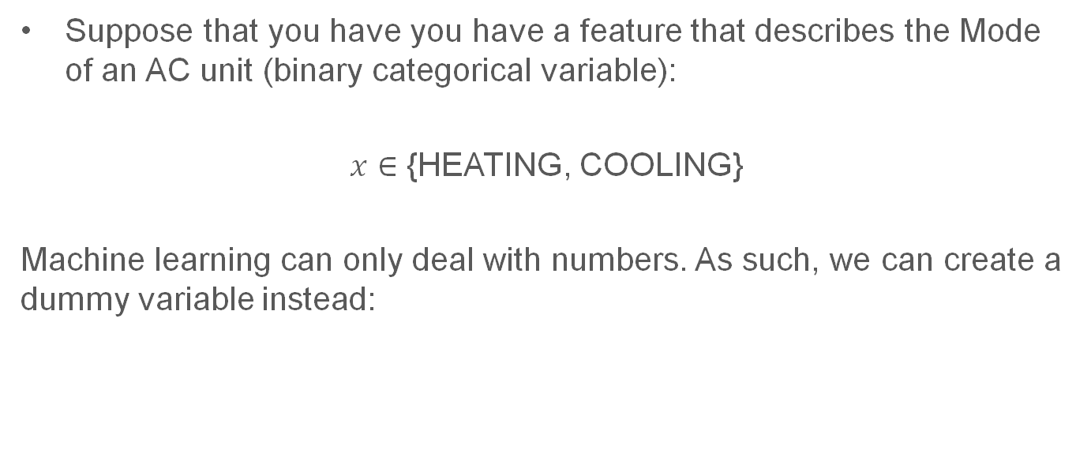

Categorical Variables and How to Use Them
Suppose that you have you have a feature that describes the Mode of an AC unit (binary categorical variable):
$x∈$ {HEATING, COOLING}
Machine learning can only deal with numbers. As such, we can create a dummy variable instead:

Slide 4

Categorical Variables
When dealing with categorical variables with more categories or classes, we instead use a technique called One-hot encoding:

Slide 5
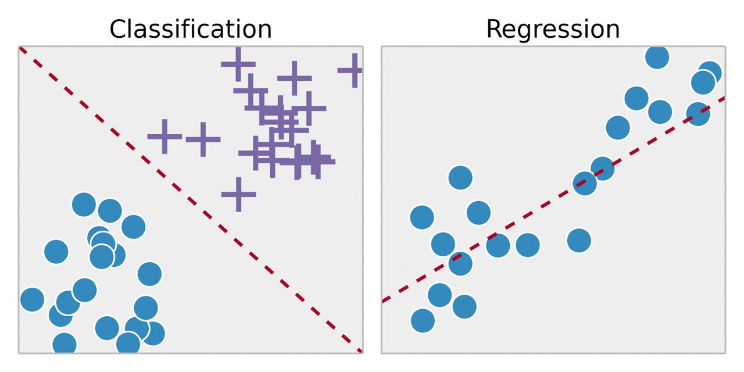
Reminder
Machine Learning
Supervised Learning
Unsupervised Learning
Reinforcement Learning
Regression
Classification
Predict a number from a continuous space (example: temperature of a room)
Predict a category or a number from a discrete set

Slide 6
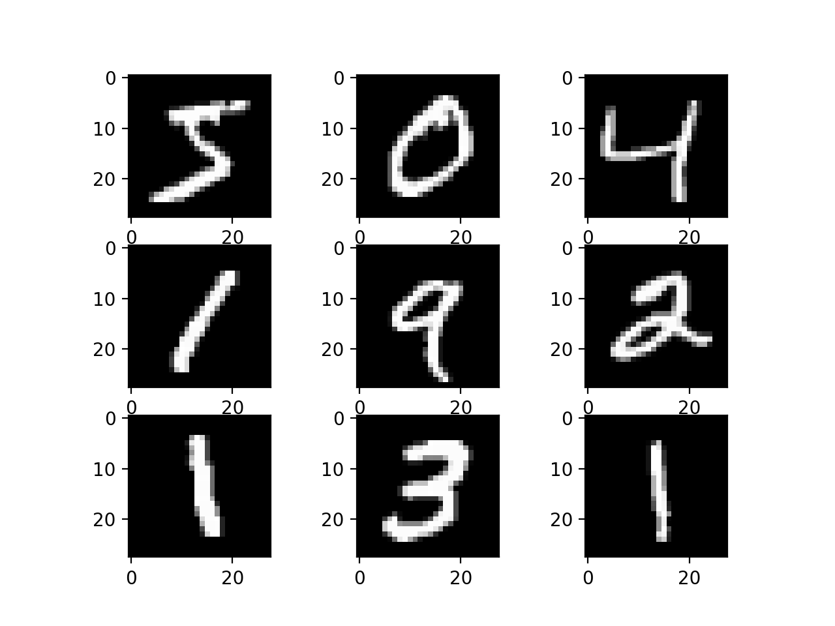
Motivation
We often want to find ways to classify phenomena and things based on data. Regression is not enough, unfortunately (not directly).
We can use tools from regression to help us with classification problems.

Slide 7
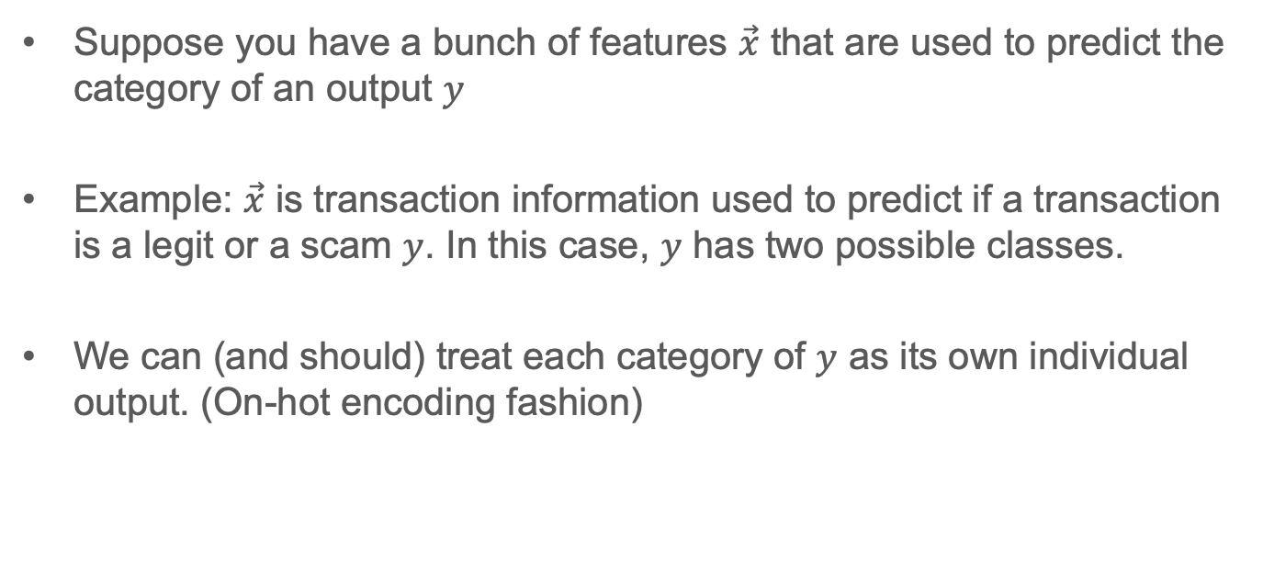
Primer: Thinking about classification
Suppose you have a bunch of features $\vec{x}$ that are used to predict the category of an output $y$
Example: $\vec{x}$ is transaction information used to predict if a transaction is a legit or a scam $y$. In this case, $y$ has two possible classes.
We can (and should) treat each category of $y$ as its own individual output. (On-hot encoding fashion)

Slide 8
















Multiclass classification task

Slide 9
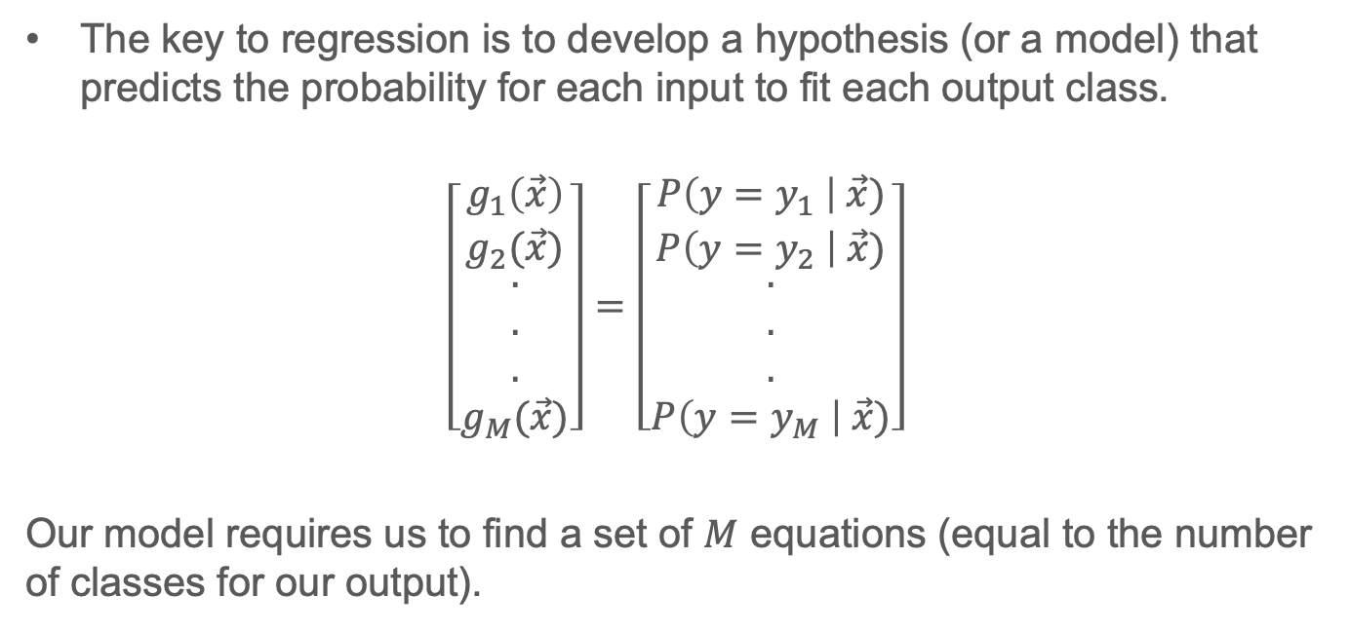
Logistic Regression
The key to regression is to develop a hypothesis (or a model) that predicts the probability for each input to fit each output class.
$$\left[\begin{aligned}\begin{aligned}g_{1}\left(\vec{x}\right) \\ g_{2}(\vec{x})\end{aligned} \\ . \\ . \\ . \\ g_{M}(\vec{x})\end{aligned}\right]=\left[\begin{aligned}\begin{aligned}P\left(y=y_{1} \right| \vec{x}) \\ P\left(y=y_{2} \right| \vec{x})\end{aligned} \\ . \\ . \\ . \\ P\left(y=y_{M} \right| \vec{x})\end{aligned}\right]$$
Our model requires us to find a set of $M$ equations (equal to the number of classes for our output).

Slide 10











Logistic Regression

Slide 11









Logistic Regression

Slide 12
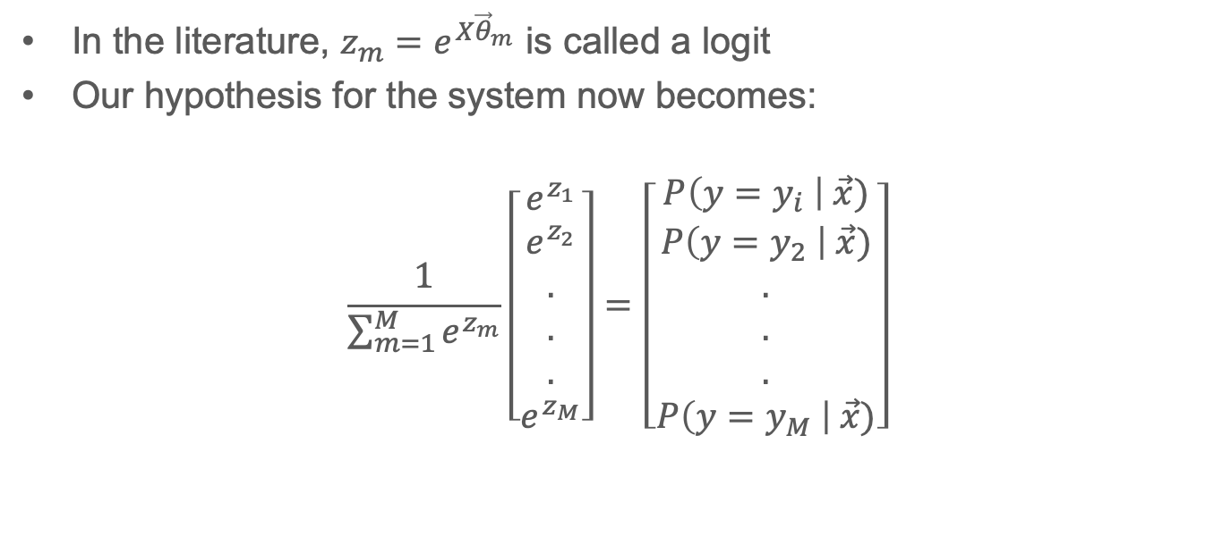
Logistic Regression Concepts
In the literature, $z_{m}=e^{X{\vec{θ}}_{m}}$ is called a logit
Our hypothesis for the system now becomes:
$$\frac{1}{\sum_{m=1}^{M}{e^{z_{m}}}}\left[\begin{aligned}e^{z_{1}} \\ e^{z_{2}} \\ . \\ . \\ . \\ e^{z_{M}}\end{aligned}\right]=\left[\begin{aligned}P\left(y=y_{i} \right| \vec{x}) \\ P\left(y=y_{2} \right| \vec{x}) \\ . \\ . \\ . \\ P\left(y=y_{M} \right| \vec{x})\end{aligned}\right]$$

Slide 13



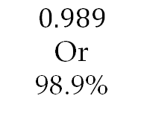
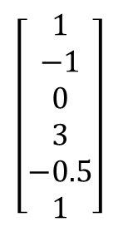


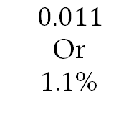







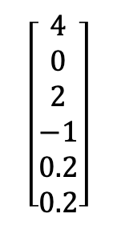

Visualizing Logistic Regression (2 classes)
Class 1 weights ${\vec{θ}}_{1}$
Apply softmax
$$\left[\begin{aligned}1 \\ −1 \\ 0 \\ 3 \\ −0.5 \\ 1\end{aligned}\right]$$
Vector multiplication
Logit $z_{1}$
$$e^{z_{1}}$$
$$g_{1}\left(x\right)=P(y=y_{1})$$
Input features x
$$2.1$$
$$8.17$$
$$0.011$$
Or
1.1%
$$\left[2.4, 3.3, −1, 1, 0, 0\right]$$
Class 2 weights ${\vec{θ}}_{2}$
$$\left[\begin{aligned}4 \\ 0 \\ 2 \\ −1 \\ 0.2 \\ 0.2\end{aligned}\right]$$
Logit $z_{2}$
$$e^{z_{2}}$$
$$g_{2}\left(x\right)=P(y=y_{2})$$
Vector multiplication
$$6.6$$
735.10
$$0.989$$
Or
98.9%

Slide 14







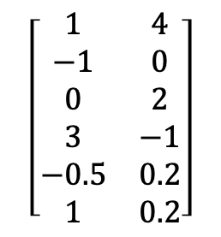




Visualizing Logistic Regression (vector approach)
Apply softmax
$$\left[\begin{matrix}1 & 4 \\ −1 & 0 \\ 0 & 2 \\ 3 & −1 \\ −0.5 & 0.2 \\ 1 & 0.2\end{matrix}\right]$$
$$\hat{y}$$
Input features x
Matrix multiplication
Logit $\vec{z}$
$$e^{\vec{z}}$$
$$\vec{g}\left(x\right)$$
$$\left[2.4, 3.3, −1, 1, 0, 0\right]$$
$$[2.1, 6.6]$$
$$[8.17, 735.10]$$
$$\left[0.011, 0.989\right]$$
Weight matrix $θ$
$$P(y=y_{1})$$
$$P(y=y_{2})$$

Slide 15

Logistic Regression Loss Function
Research shows that MSE is not a good loss function for classification problems.
For classification problems, a measure of certainty of your output random variable. This certainty (or lack thereof) is called entropy.
The higher the entropy of a random variable, the less information, and more random it conveys.

Slide 16












Categorical Cross Entropy

Slide 17
References
Materials from this slides (slide 3 – 16) used Machine Learning, A First Course for Engineers and Scientists by Lindholm et. al (March 4th, 2026 version), section 3.2 as a reference. Access to this document is free at the publishers’ GitHub page.

Slide 18
Extra notes

